Slide 1
PwC Labs
AutoTrack 360

Slide 2
Automation@PwC (Spoke) – Operating Framework
Operating Model
PwC Labs
Enterprise Production Support
IFS
Technology
Build, Operate & Maintain
Value Stream/Process Reengineering
Opportunity Discovery
Demand Management: Process Assessment & Prioritization
Technology Suitability
Benefit Assessment & Realized Value Mgmt.
Risks Identification
Escalations Issues & Incident Resolution
Project Execution
Production Support Model
SERVICES &
RESOURCES
License procurement
Vendor engagement
Architecture & Security compliance
Risks / issues resolution
Project communication
Process, Tech and Operational Policies & Procedures
Infrastructure Mgmt. & Support
Platform Mgmt.
Technology Selection
A@PwC
CoE
Business Functions
Infrastructure & Security
Enterprise Architecture
GDN
Procurement & Vendor Mgmt
Industry insights

Slide 3
AutoTrack 360 - Enterprise Automation Hub
Automation management portal to track, measure and manage the Automation lifecycle from Discovery through Approval, Development, Testing, Deployment and Production Control & Mgmt.
The Analytics Dashboards provide a 360 degree view of the status of automation projects and operational and realized value management metrics for deployed digital assets. The metrics can be viewed by various levels including LoS, Business Function, Process, etc. Key dashboard features include:
PwC & External Enterprise
Demand Management
Pre-deployment automation workflow and management across lifecycle phases, i.e. Ideation, Approval, Development, Testing, etc.
Visual alerts to trigger governance and management actions.
Operational KPIs such as AHT, STP, Quality, Utilization, etc.
Realized value management measures such as FTE Hours Delivered, ROI, etc.
Comparison of Baseline vs. Actuals
Responsive web design to render pages across various devices and screen sizes.
Ability to export and upload documents and reports
Workflow & Governance
Operations Management

Slide 4






AutoTrack 360 – Workflow Framework
Operating Model
Demand Management
Development
Operations
Build
Idea Discovery
Validate Idea
Business Case
Approve Idea
Define
Design
UAT
Deploy
Support Maintain & Operate
Test

Slide 5
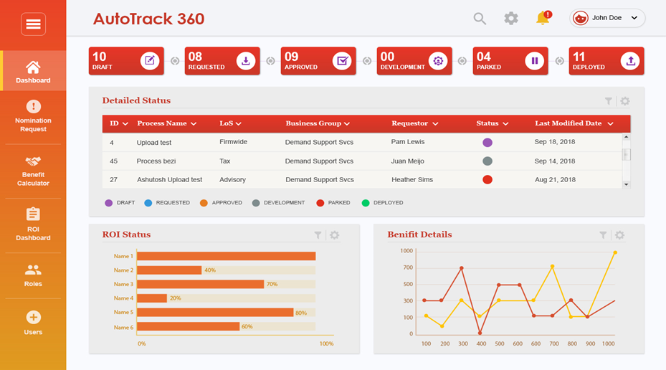
AutoTrack360 - Automation@PwC Portal

